Slide 1
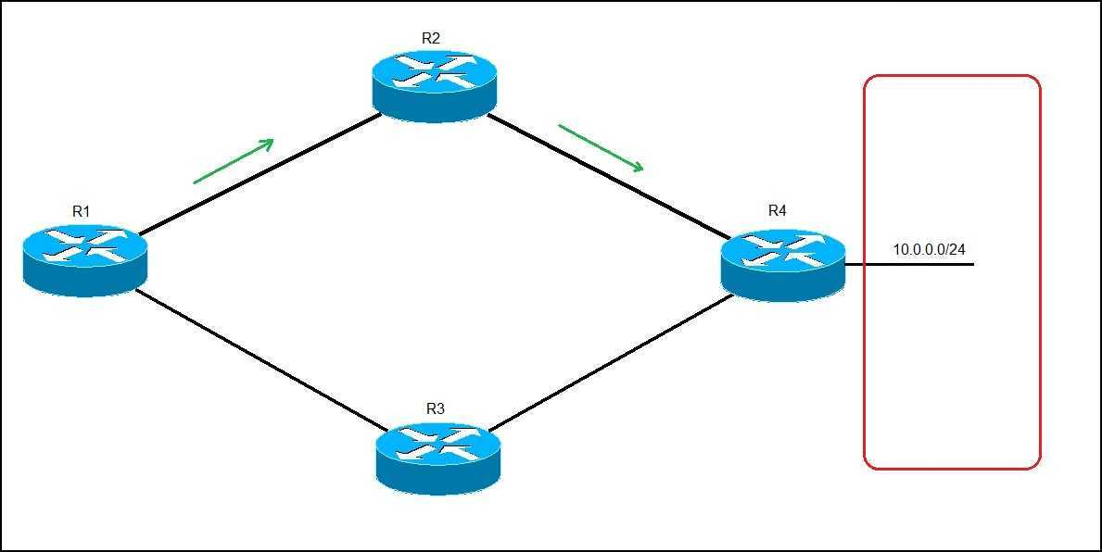
Pract- 4 Dynamic Routing

Slide 2
What is Dynamic Routing ?
Dynamic routing is known as a technique of finding the best path for the data to travel over a network in this process a router can transmit data through various different routes and reach its destination on the basis of conditions at that time of communication circuits.

Slide 3
How the Dynamic Routing is performed ?
The dynamic routing is performed with the help of dynamic routing protocols are( example ) BGP, and RIP that you can choose according to your topology, specific requirements ( like scenario: WAN, Internet Edge, Data Center, SP networks), technical capabilities (vendor, type of devices, supported protocols) and so on.
Routing Information Protocol (RIP) is a dynamic routing protocol that uses hop count as a routing metric to find the best path between the source and the destination network.

Slide 4
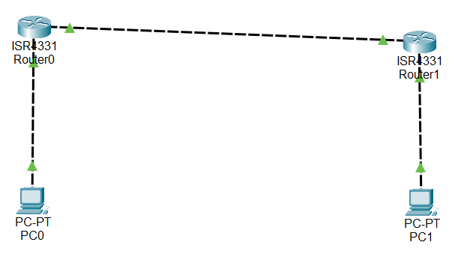
Implementation of dynamic routing in cisco packet tracer .

Slide 5
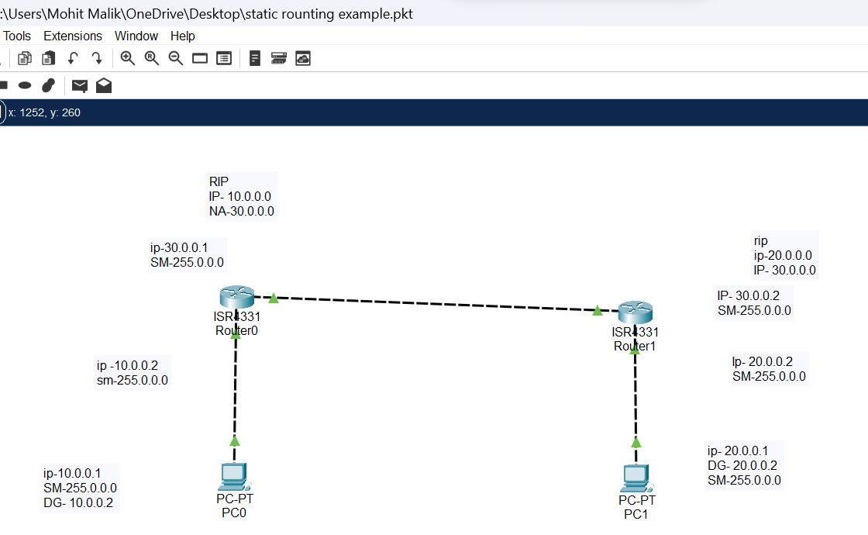
Implementation of dynamic routing in cisco packet tracer .

Slide 6
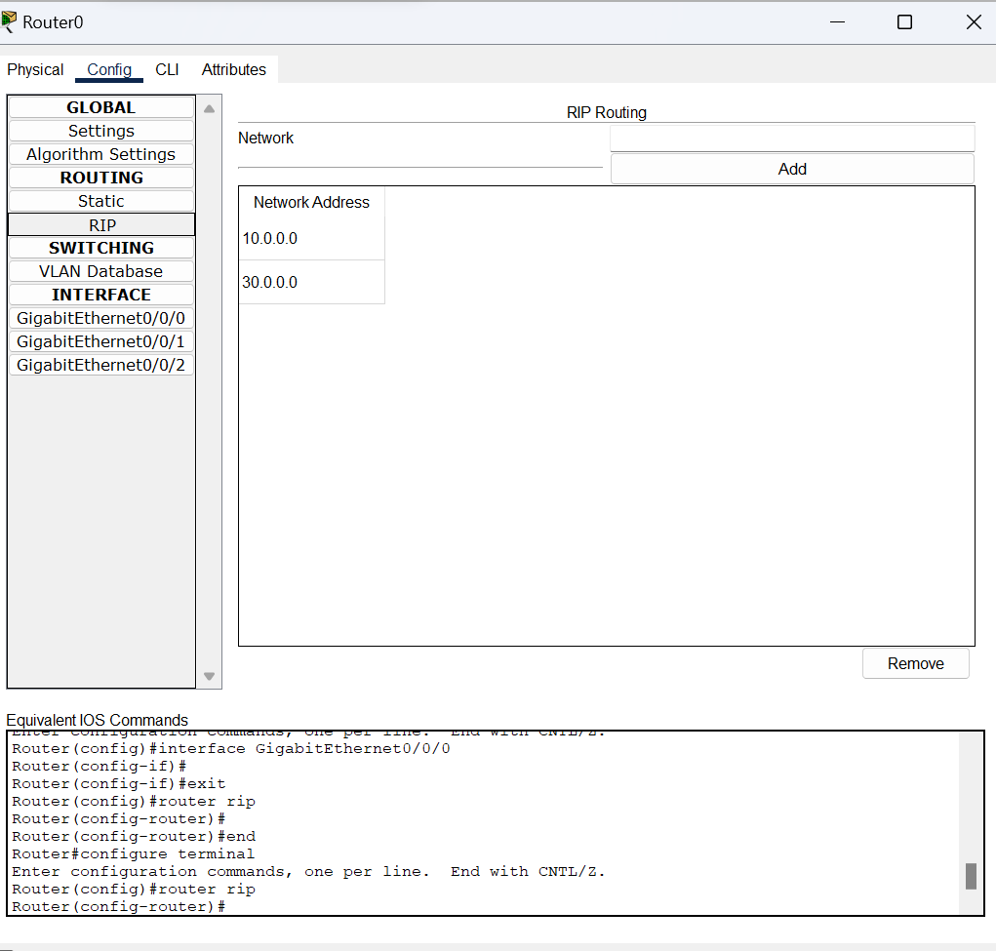
How to use the RIP in cisco packet Tracer.

Slide 7
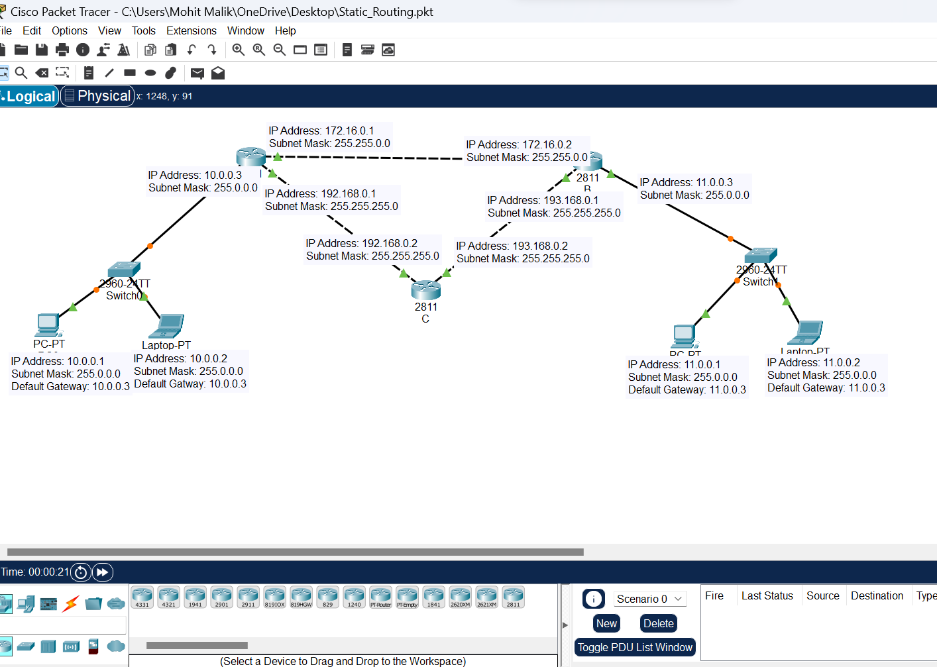
Example 2 of Dynamic Routing.

Slide 9
Router A (RIP)
A(config)#router rip
A(config-router)#network 10.0.0.0
A(config-router)#network 172.16.0.0
A(config-router)#network 192.168.0.0

Slide 10
Router B (RIP)
B(config)#router rip
B(config-router)#network 172.16.0.0
B(config-router)#network 193.168.0.0
B(config-router)#network 11.0.0.0

Slide 11
Router C (RIP)
C(config)#router rip
C(config-router)#network 192.168.0.0
C(config-router)#network 193.168.0.0

Slide 12
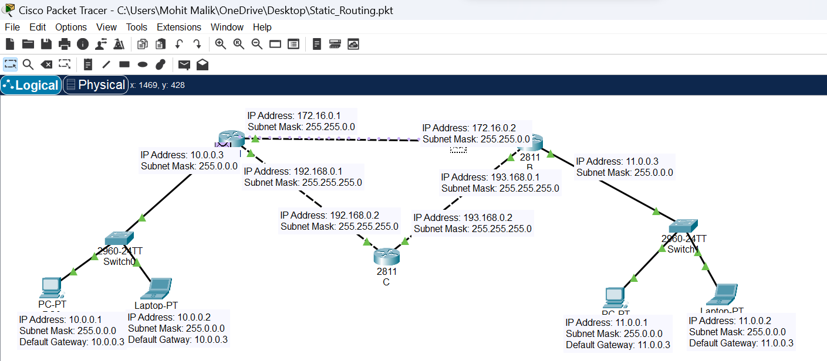
Message send from PC0 to PC1.

Slide 13


